Slide 1

DevOps Task Implementation
Created By: Rishabh Khari

Slide 2

Contents
Problem Statement
Solution
Implementation
Results

Slide 3
Problem Statement: Deploying Grafana and Traefik on a Virtual Machine
TASK: deploy Grafana and Traefik on a virtual machine running Rocky Linux Server 9.1 (minimal).
GOAL: provide a web-based interface for monitoring and visualizing data.
CHALLENGE: deploy Grafana and Traefik on the virtual machine and configure them to work together.
Additionally, we need to ensure that Grafana is accessible via the URL ald-expert.com/grafana.

Slide 4





The following tools were utilized to solve the problem statement
Virtual Machine:
You used Vmware Workstation 17 Player to create a virtual machine.
Docker and Docker-Compose:
installed Docker and Docker-Compose on the virtual machine.
used Docker-Compose to deploy Grafana and Traefik on the virtual machine.
Grafana and Traefik:
created a docker-compose.yml file that defined the services and configurations for Grafana and Traefik.
used traefik.http.routers.grafana.rule label to route requests to Grafana via the URL ald-expert.com/grafana.
used the StripPrefix middleware to remove the /grafana prefix from the URL before forwarding the request to Grafana.
Additional Tools:
used a VIM text editor to create and edit the docker-compose.yml file on VM.
used the terminal to run commands and manage the VM.

Slide 5
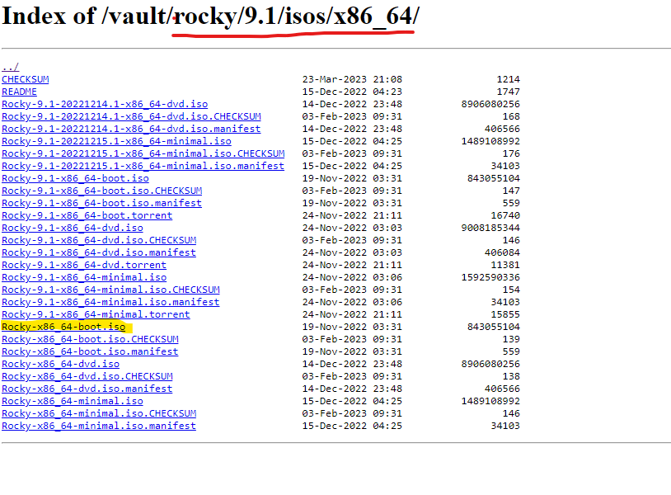
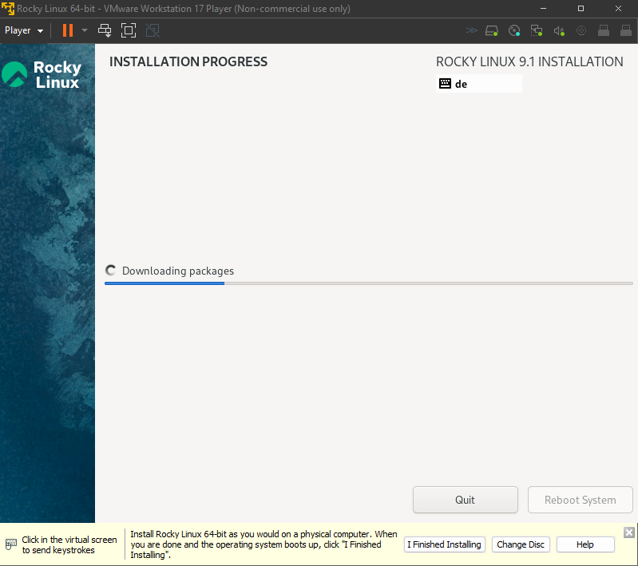
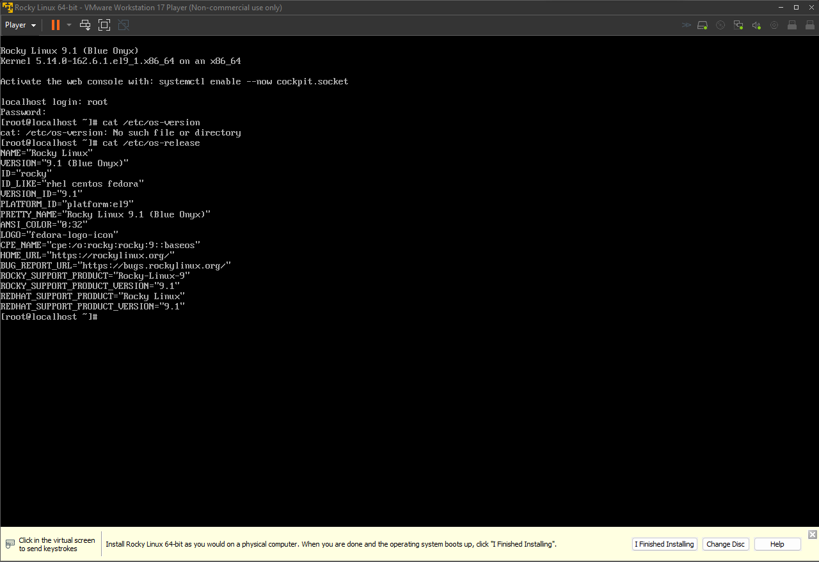
Implementation: setting up the Virtual Machine
Downloaded the Rocky Linux 9.1 minimal ISO
Created a new virtual machine using the ISO

Slide 6
Implementation: Installing Docker & Docker Compose
Install Docker:
Execute the commands to install and start Docker.
sudo dnf install docker
sudo systemctl start docker
Enable Docker:
Ensure Docker starts on boot
sudo systemctl enable docker
Install Docker-Compose:
Use the command to install Docker-Compose
sudo dnf install docker-compose

Slide 7
Implementation: Deploying Grafana and Traefik
Create a Directory:
Make a directory for Docker-Compose configuration files and navigate into it.
mkdir test
Docker-Compose File: Create a docker compose file with specifications for Traefik and Grafana.
Vim docker-compose.yml
Traefik Configuration: Configure Traefik as a reverse proxy with specific settings, including exposing the API and Docker provider.
Grafana Configuration: Specify Grafana settings, such as the image, environment variables (e.g., admin password), and Traefik labels for routing.

Slide 8
Implementation: Grafana config
The YAML file contains this Grafana configs
Notes:
ports: Traefik is exposed on ports 80 (for HTTP traffic) and 8080 (for the Traefik dashboard).
command: Specifies the command-line options for Traefik. Notably, --api.insecure=true enables the insecure API for the Traefik dashboard. Adjust security settings as needed for a production environment.
volumes: Mounts the Docker socket into the Traefik container. This allows Traefik to dynamically discover and configure routes for services running in Docker.
networks: Defines a network named web for the services. If used, ensure it matches the network configuration in other services.
This configuration assumes that Traefik will dynamically discover and route traffic to services based on Docker labels.

Slide 9
Implementation: Traefik config
The YAML file contains these traefik configs:
Notes:
Exposing Ports: The ports section exposes ports 80 and 8080 for HTTP traffic and the Traefik dashboard, respectively.
Traefik Command Options: The command section specifies various command-line options for the Traefik container, including enabling the insecure API, using the Docker provider, not exposing all services by default, and setting the web entry point's address.
Docker Socket: The volumes section mounts the Docker socket into the Traefik container, allowing dynamic discovery and configuration of routes for services running in Docker.
Labels for Traefik Middleware: The labels section includes configurations for Traefik middleware. It enables Traefik for this service, configures the strip-prefix middleware to remove the /grafana prefix, and specifies not to force a trailing slash after the prefix is stripped.

Slide 10
Implementation: Accessing Grafana and Traefik
Update /etc/hosts on VM
Open the hosts file
sudo nano /etc/hosts
add an entry like “{local IP Address} ald-expert.com” for accessing Grafana via the specified DNS.
Used ifconfig to access IP address of the VM
Update the HOSTS file used by Microsoft TCP/IP for Windows
Open the hosts file in notepad++
Location: C:\Windows\System32\drivers\etc\hosts
Add entry as earlier mentioned

Slide 11
Implementation: deploying Grafana and Traefik
Docker compose file was deployed and monitored:
Deploy:
Docker compose up –d
Monitoring:
Docker ps –a
Docker compose logs –f (traefik || Grafana)

Slide 12
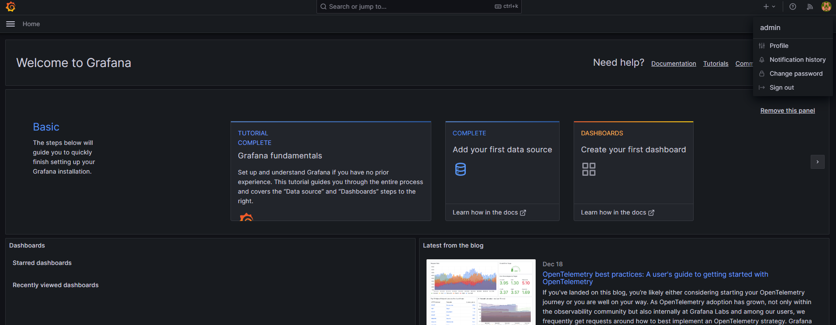
Results
Grafana and Traefik post deployment were accessible
Grafana via (http://ald-expert.com:3000/grafana)

Slide 13
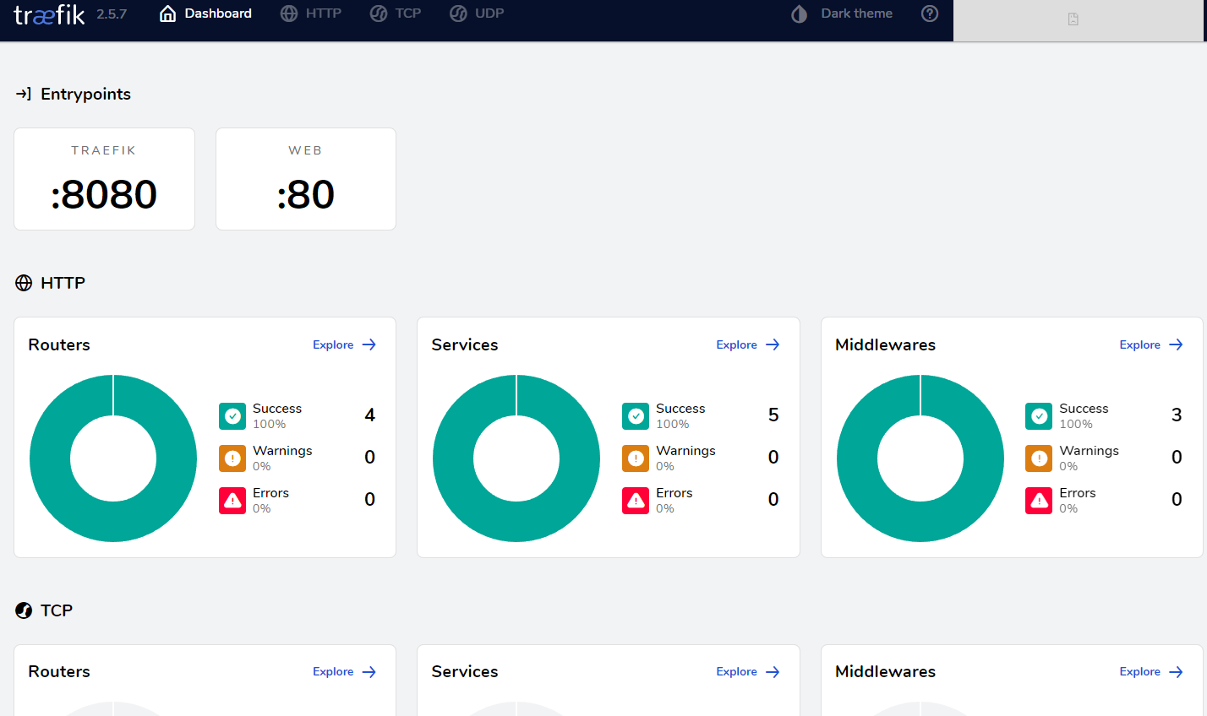
Results
traefik via (http://ald-expert.com:8080/dashboard)

Slide 14
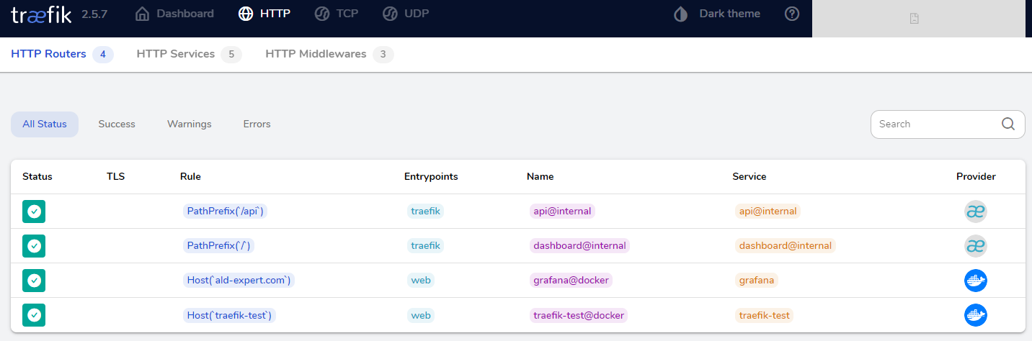
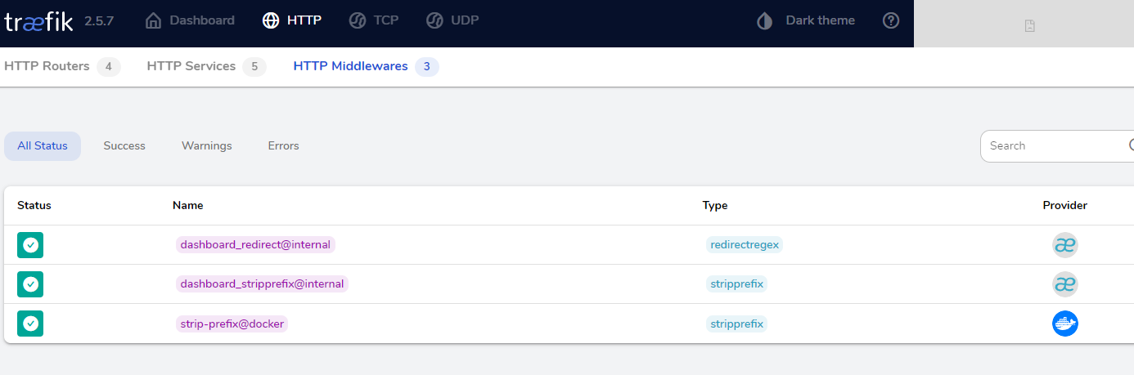
Results
traefik via (http://ald-expert.com:8080/dashboard)

Slide 15
Challenges faced
Version Compatibility:
Challenge: Upgrading Rocky Linux to version 9.3 during Docker installation.
Solution: Suggested reinstalling Rocky Linux 9.1 to avoid unintentional upgrades.
Middleware Configuration:
Challenge: Issues with configuring Traefik middleware for path stripping.
Solution: Collaboratively addressed middleware configuration, ensuring proper routing for Grafana.
Path Prefix and Reverse Proxy:
Challenge: Configuring Traefik to handle the path prefix as per the interview task.
Solution: Provided guidance on Traefik labels and middleware to address the path prefix requirement.
Troubleshooting Grafana Access:
Challenge: Difficulties accessing Grafana as per the specified DNS.
Solution: Collaboratively identified potential issues, checked DNS resolution, and ensured proper configuration.

Slide 16
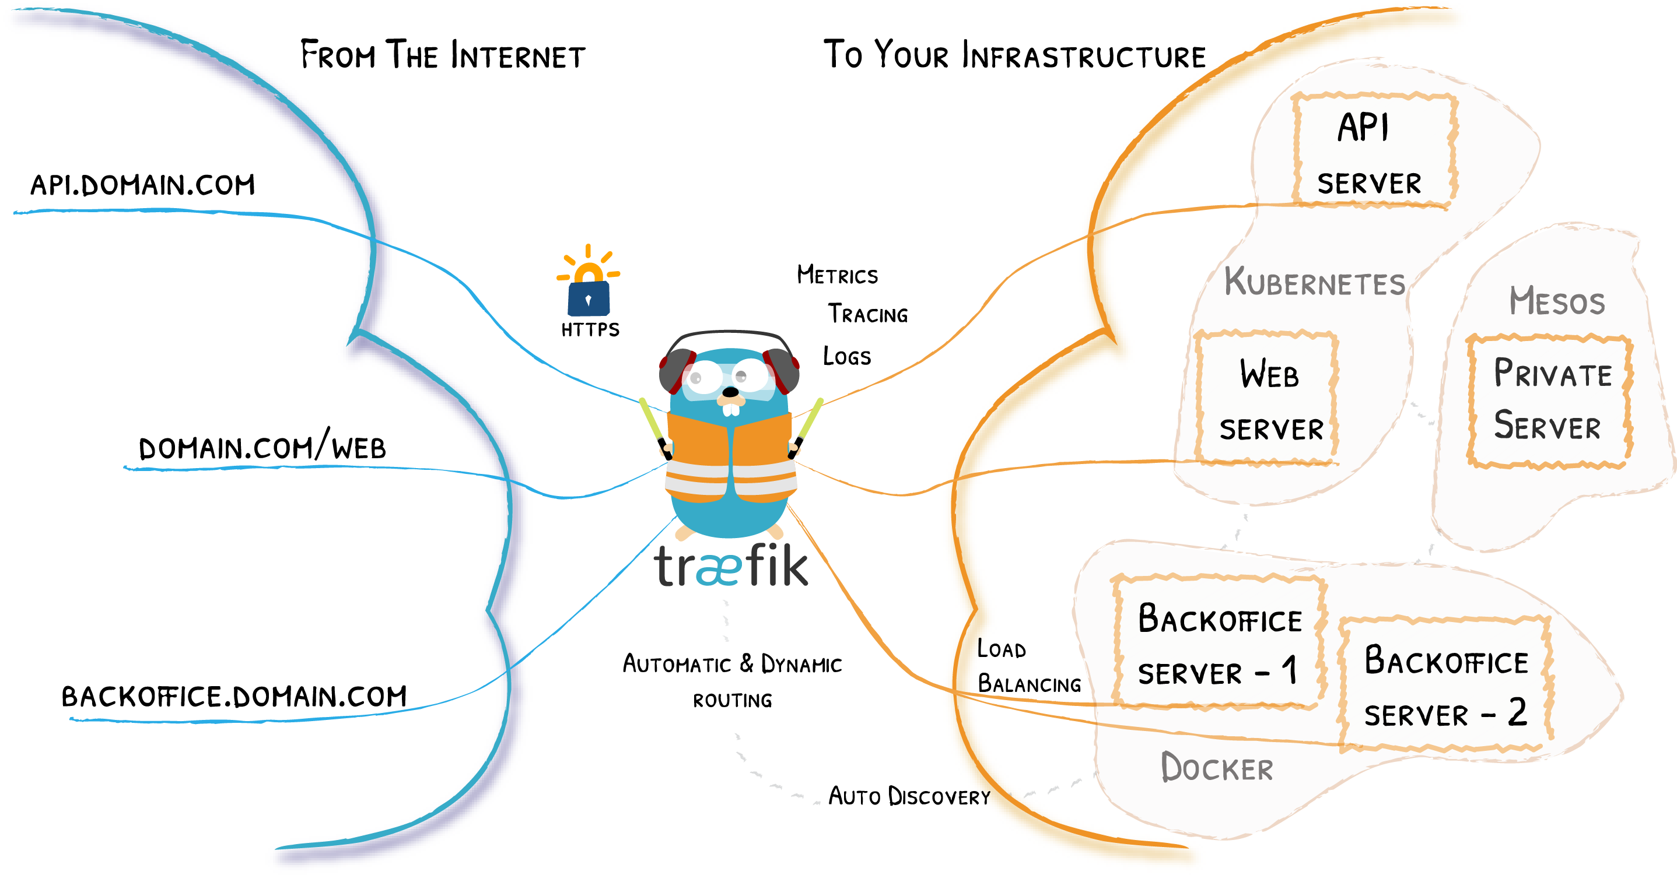
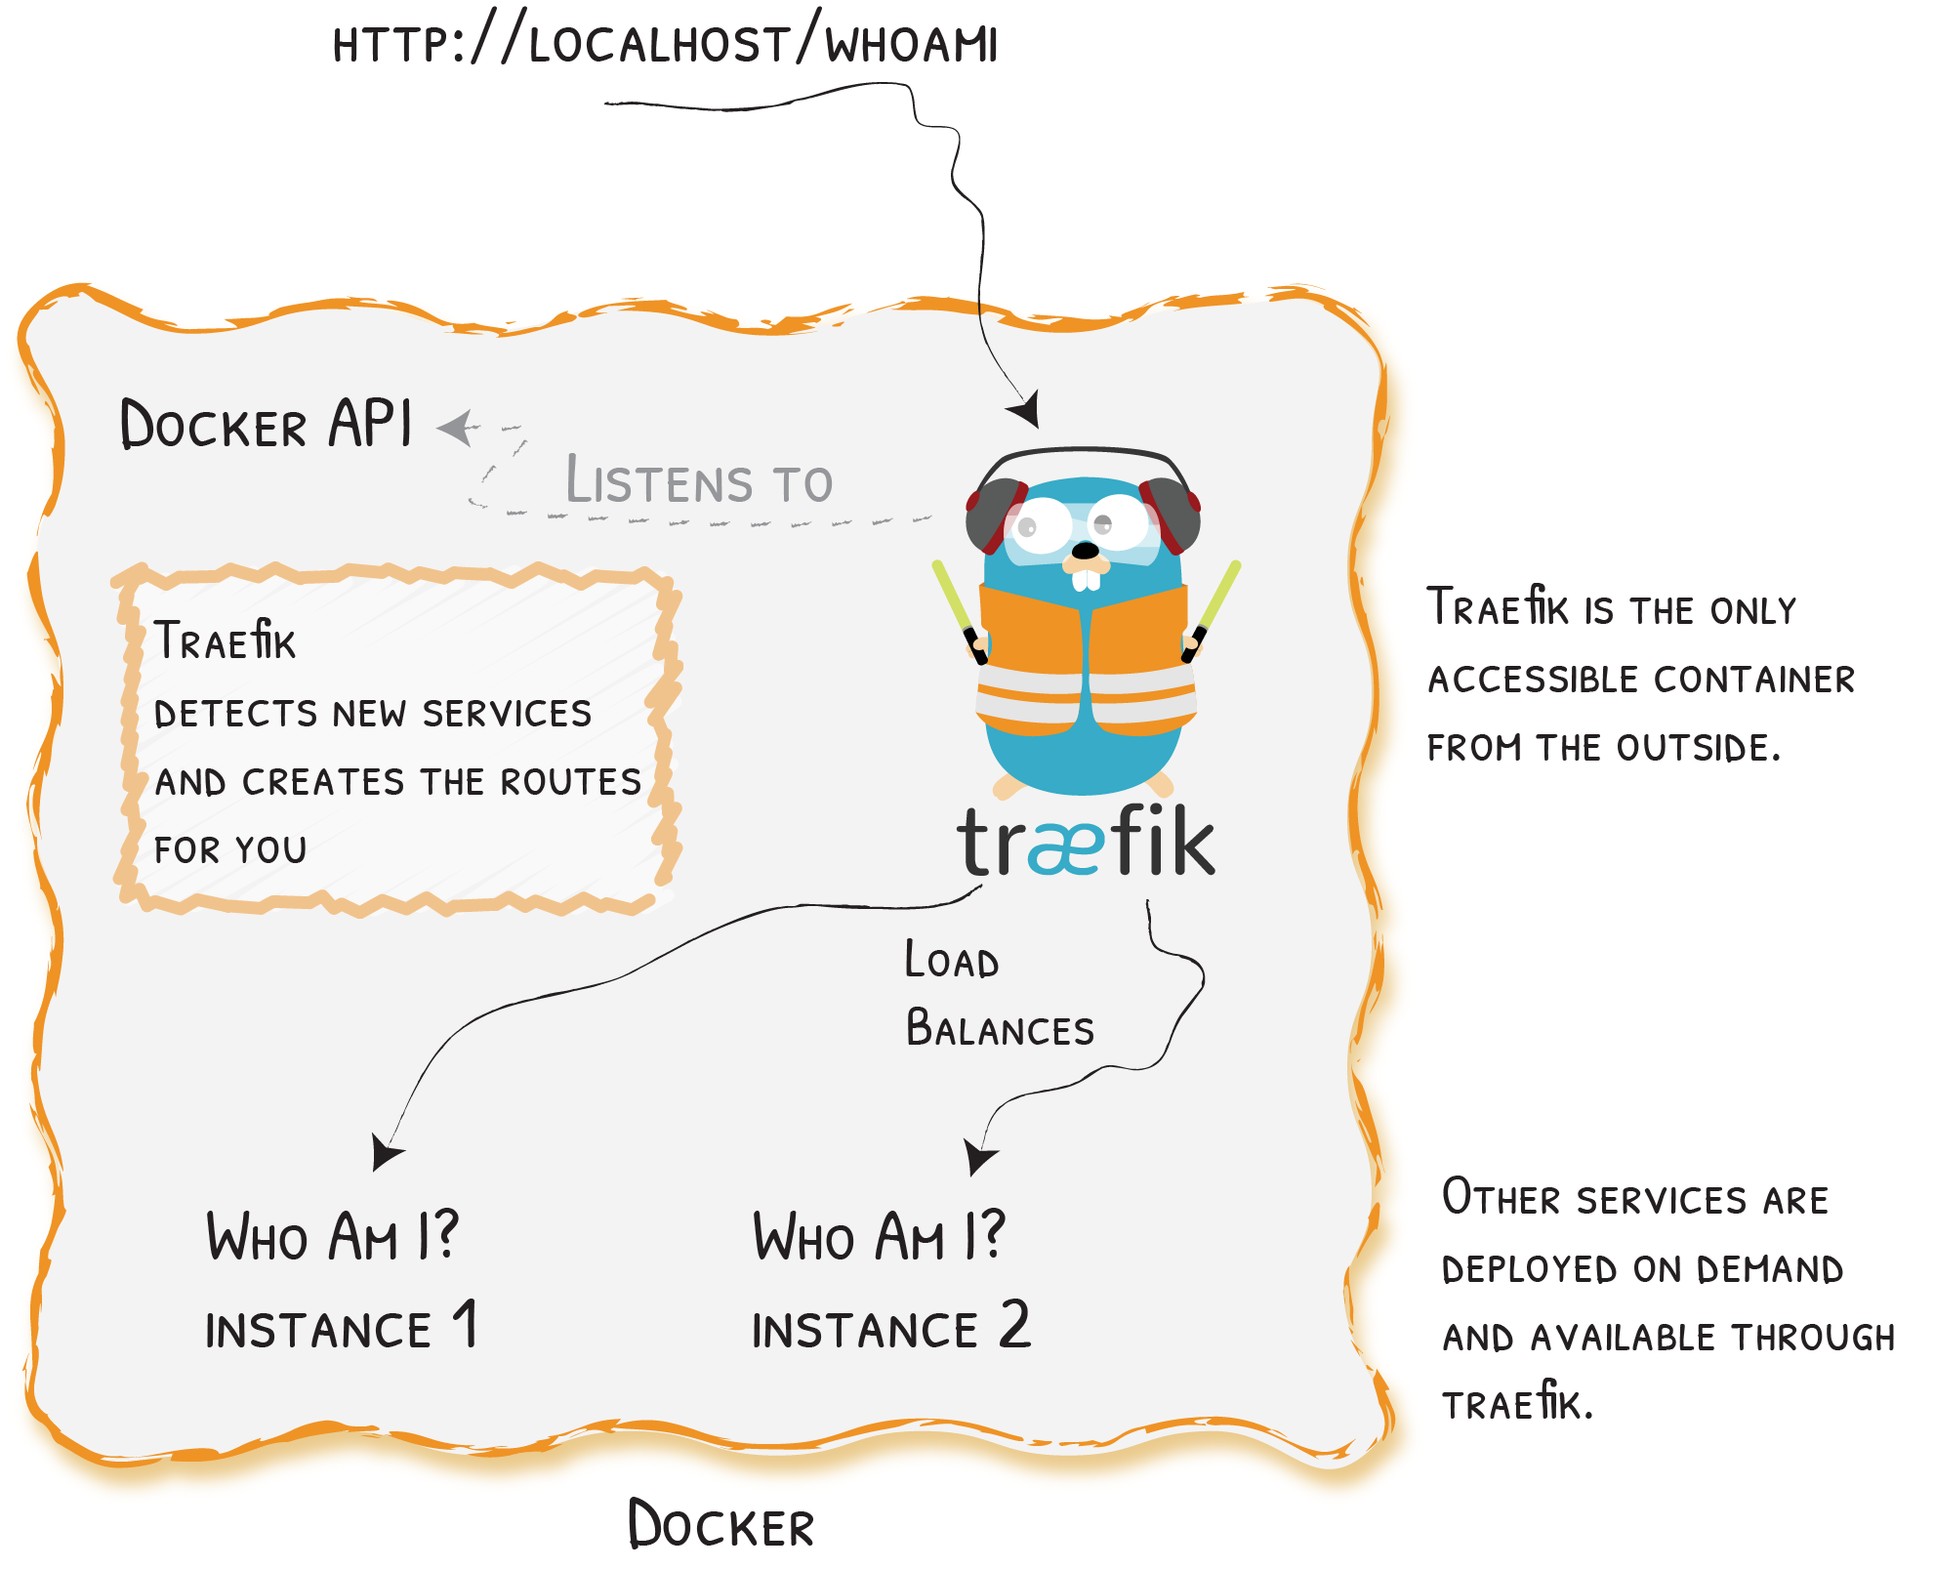
Vision for Production Scalability and Security

Slide 17
Vision for Production Scalability and Security
Scalable and Secure Architecture | Maintaining Docker Images | Securing the environment
Load Balancing for High Availability Continuous Monitoring and Optimization Automated Scaling Strategies | Container Orchestration Image Versioning Monitoring and Logging | Traefik Middleware Network Isolation Secure Communication Access Controls
Notes:
Scalable and Secure Architecture:
Load Balancing for High Availability: Envision Traefik orchestrating load balancing, ensuring high availability across multiple instances to prevent bottlenecks and downtime.
Continuous Monitoring and Optimization: Picture a production environment where Traefik is continuously monitored and optimized to maintain peak performance and address evolving security considerations.
Automated Scaling Strategies: See the implementation of automated scaling strategies, where Traefik responds to increased demand by dynamically provisioning additional resources, ensuring smooth operations during traffic spikes.
2. Maintaining Docker Images:
Container Orchestration:
Employ Docker Compose or Kubernetes for efficient container orchestration.
Streamline tasks such as scaling, updating, and monitoring client Docker containers.
Versioning Strategies:
Implement versioning for client Docker images to facilitate updates and rollbacks.
Ensure a structured approach to managing different releases of client applications.
Monitoring and Logging:
Integrate monitoring and logging tools to maintain the health and performance of client Docker containers.
Utilize tools like Prometheus, Grafana, or ELK stack for comprehensive insights.
3. Securing the Environment:
Traefik Middleware:
Leverage Traefik middleware to enforce security policies for client services.
Implement middleware configurations for rate limiting, access control, and additional security measures.
Network Isolation:
Utilize Docker networks to isolate client services and control communication between them.
Establish network policies to enhance security and prevent unauthorized access.
Secure Communication:
Enable HTTPS for communication with Traefik, ensuring secure data in transit.
Leverage Traefik's SSL certificate management for robust encryption.
Access Controls:
Implement stringent access controls at both the Docker and Traefik levels.
Ensure only authorized users and services have access to client Docker containers and Traefik configurations.

Slide 18
Thank you for your time and attention
Questions ?

